Slide 1
Spatial Genomics Group, Department of Geography
Intro to Demographic Simulations
    Billy Wallisch
    16 September 2026
Notes:
Good afternoon. I simulate populations — how many individuals there are, how much genetic variation they carry, and whether the first can be used to predict the second while the climate is moving. I want to start with a question you cannot answer.

Slide 2
Where this is going
Problem
Solution
Method
We monitor genetic
diversity by counting
individuals.
Simulate populations
where we know the
truth.
SLiM, four demes,
the real Swiss
climate.
Notes:
Three parts, and I will say which one we are in as we go. First the problem: the global indicator for genetic diversity is, in practice, a head count. Then the solution: simulate populations where the true answer is known. Then the method, and two early results. Ten seconds on this slide.

Slide 3
Problem: same size, different futures
Population A
Population B
500
500
Which one survives?
Notes:
Two populations. Same species, same habitat, same head count — every monitoring scheme in the world scores these identically. The squares are their genetic variation, and on that they are nothing alike. Ask the room to pick one. They cannot. Neither can a programme that only counts.

Slide 4
Problem: selection can only use variation already there
Drift removes it
Inbreeding compounds
Mutation is too slow
every generation, by chance
relatives breed with relatives
it never keeps up
And it happens before the numbers fall.
Notes:
Selection is a filter, not a factory. It can only act on variation already present — if the warm-tolerant individuals were never there, no amount of pressure produces them in time. And that variation drains: lost to chance every generation, compounded by inbreeding, replaced by mutation far too slowly. The part that matters for conservation is the bottom line: this happens before you see anything in a head count. By the time numbers fall, the adaptive capacity has often already gone.

Slide 5
Effective size is not a head count
How fast diversity actually drains
Not everyone breeds
Some breed far more
Numbers fluctuate
Typically about a tenth of the head count.
Effective size: the size of an idealised population losing diversity at the same rate. Ratio to census size ≈ 0.1 (Frankham 1995).
Notes:
Ten seconds, because everything after this depends on it. Effective size is not how many animals there are. It is how many there would have to be, in a perfectly behaved population, to lose diversity as fast as this one does. Not everyone breeds; a few parents often dominate; a single crash weighs more than years of plenty. Each pushes the effective number below the head count — across wildlife, to roughly a tenth of it.

Slide 6
500 is a claim about the future, not the present
50
500
Survive now
Keep adapting
A population can look healthy and have no future.
The 50/500 rule: Franklin & Soulé (1980). Frankham et al. (2014) argue for 100/1000 — a rule of thumb, and a contested one.
Notes:
Two thresholds answering different questions. Around fifty is about getting through the next few generations without inbreeding depression — survival now. Around five hundred is about still being able to adapt in a century — survival later. The second number is the one that ended up in policy. Flag that it is contested: Frankham and colleagues argue it should be a thousand. Say it before someone in the room says it to you.

Slide 7
Genetic diversity is now a policy target
“Maintain the genetic diversity within populations of wild species.”
Kunming–Montreal Global Biodiversity Framework, Goal A
Agreed 2022
4 goals, 23 targets
Countries must report
in Montreal
the global plan to 2030
on a schedule
Convention on Biological Diversity, COP15 (2022). Goal A and Target 4 both cover genetic diversity.
Notes:
One slide on what the framework is, for anyone who has not met it. The UN biodiversity agreement signed in Montreal at the end of 2022 — four goals, twenty-three targets, out to 2030. What matters here: genetic diversity of wild populations is named explicitly, and countries have to report against it. That is what turned five hundred from an academic rule of thumb into a number with consequences.

Slide 8
Problem: nobody can sequence everything, every year
What we want
What we get
Genome diversity,
everywhere,
repeatedly
A head count
Impossible
Affordable
Notes:
So the agreed indicator is a demographic proxy. You count individuals, you count occupied populations, and you infer the genetics. It is a completely reasonable compromise — it is the only affordable one. The question is whether the inference holds.

Slide 9
So the indicator counts individuals instead
N
× 0.1
Nₑ
> 500?
Count
Convert
Estimate
Compare
The genetic indicator is a demographic measurement.
GBF headline indicator A.4: proportion of a species’ populations with effective size above 500. Default conversion Nₑ:N = 0.1.
Notes:
Do not rush this slide — it sets up the whole thesis. An indicator is a stand-in: not the thing itself, but something measurable enough to report on a schedule. The headline indicator for genetic diversity is A.4 — what proportion of a species' populations have an effective size above five hundred. And here is how it is computed when nobody has DNA: count the individuals, multiply by a tenth, compare with five hundred. Land the bottom line, then pause.

Slide 10
Problem: that ratio assumes a world that sits still
Sizes are falling
Selection is strong
Migration reshuffles
not stable
and directional
who breeds where
Climate change breaks every assumption behind it.
Notes:
Every textbook relationship between census size and genetic diversity assumes a population at equilibrium — stable size, stable environment, no directional selection. Under climate change none of that holds. Sizes are moving, selection is strong and pointed one way, and migration is redistributing who breeds where. Nobody has checked what that does to the indicator. That is the gap I am working in.

Slide 11
Solution: simulate what we cannot observe
No control
Switzerland
No rewind
button
So build
one
A population where the true answer is known.
Notes:
To test a predictor you have to know the outcome. That means watching real populations from 1940 to now, many times over, so you can tell signal from luck. There is no such dataset and there never will be. So instead you build a population where you know everything — every individual, every genome, every generation — and you test the predictor against a truth you can actually see.

Slide 12
Method: forward in time, one individual at a time
1
2
3
4
5
Born
Grows
Survives?
Moves
Breeds
Repeat four thousand times.
Notes:
Forward-time, individual-based simulation. No equations for population averages — you simulate the individuals and the averages emerge. Every organism is an object with its own genome. It is born, it grows into a phenotype, this year's climate decides whether it lives, some individuals move to another site, the survivors breed. Repeat four thousand times. That is expensive, and it is why it can do things analytical models cannot.

Slide 13
SLiM
Notes:
Section break.

Slide 14
Method: SLiM does this, with real genomes
Forward-time
Individual-based
Genetically explicit
1940 to 2025
every organism an object
chromosomes, recombination
Free, and it runs on a laptop.
Haller & Messer, SLiM — messerlab.org/slim
Notes:
SLiM is the standard tool for this, written by Ben Haller and Philipp Messer. Forward-time, individual-based, genetically explicit. You describe the biology in a small scripting language called Eidos and SLiM does the bookkeeping for millions of individuals and their genomes. It is free and it runs on a laptop — the cluster is only for running hundreds of replicates at once.

Slide 15
Method: four questions, every generation
1
Which mutations?
2
Which trait?
3
Fits this year?
4
Survives?
Notes:
This is the whole conceptual machine, and it is worth saying out loud, because once people have these four questions they can follow any model I show them. What mutations does this individual carry? What trait does that genotype give it — here, a temperature tolerance. Does that tolerance fit this year's actual climate? And does it survive and breed? Everything else in a SLiM script is bookkeeping.

Slide 16
Method: one line carries the biology
phenotypes =
inds.countOfMutationsOfType(m2);
climateFitness = 1.0 -
(phenotypes - popOptima)^2
* selectionStrength;
inds.fitnessScaling = climateFitness;
Further from the optimum,
fewer offspring.
grib_ramp_v2_treeseq_parameterized.slim
Notes:
Do not walk through the syntax. Point at the middle block and say it in words: the further an individual sits from the temperature its site now demands, the fewer offspring it leaves, and the penalty grows with the square of the gap. That single line is the entire mechanism by which climate change kills a population in this model.

Slide 17
Method: SLiM records every family tree
Exact, not estimated
A few megabytes
Re-measurable
the true genealogy
per whole run
without re-running
This is what makes the question answerable.
Notes:
Instead of sequencing simulated organisms, SLiM records the genealogy of every chromosome as it goes — a tree sequence. Recombination means different parts of the chromosome have different ancestries, so it is a series of trees along the genome. Diversity and effective size are then read off the true genealogy rather than estimated from sequence. Optional aside if the room is with you: my first genome barely recombined and gave 54 distinct trees per run — effectively one locus. Rebuilding it gave about eleven thousand nine hundred. Same biology, usable measurement.

Slide 18
My project
Notes:
Section break. From here it is my own work.

Slide 19
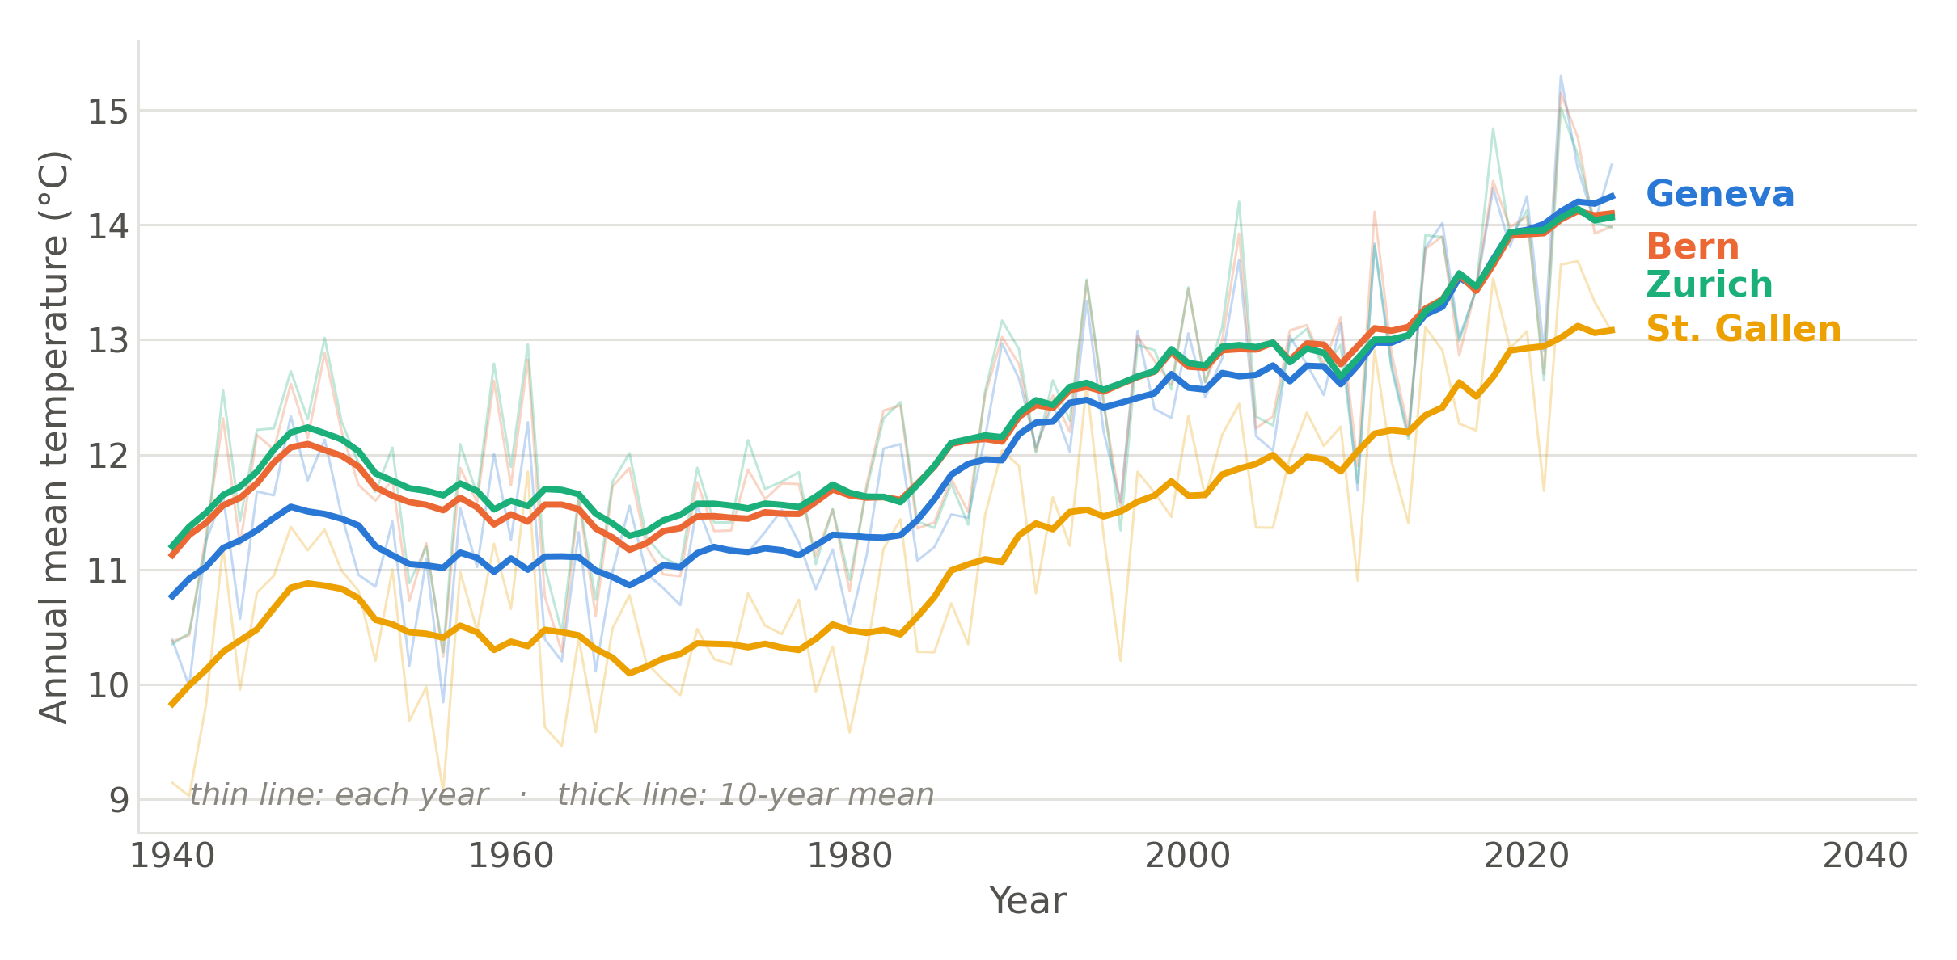
Method: the climate that actually happened
Not a scenario. The observed record.
ERA5 reanalysis, annual mean 2 m temperature, 1940–2025, at the four population locations.
Notes:
This is the forcing. Four locations across the Swiss Plateau, annual mean temperature, 1940 to 2025, from reanalysis. It is not a projection or a scenario — it already happened. The populations in my model live through this exact series. About two degrees over the record, and you can see it is not gradual.

Slide 20
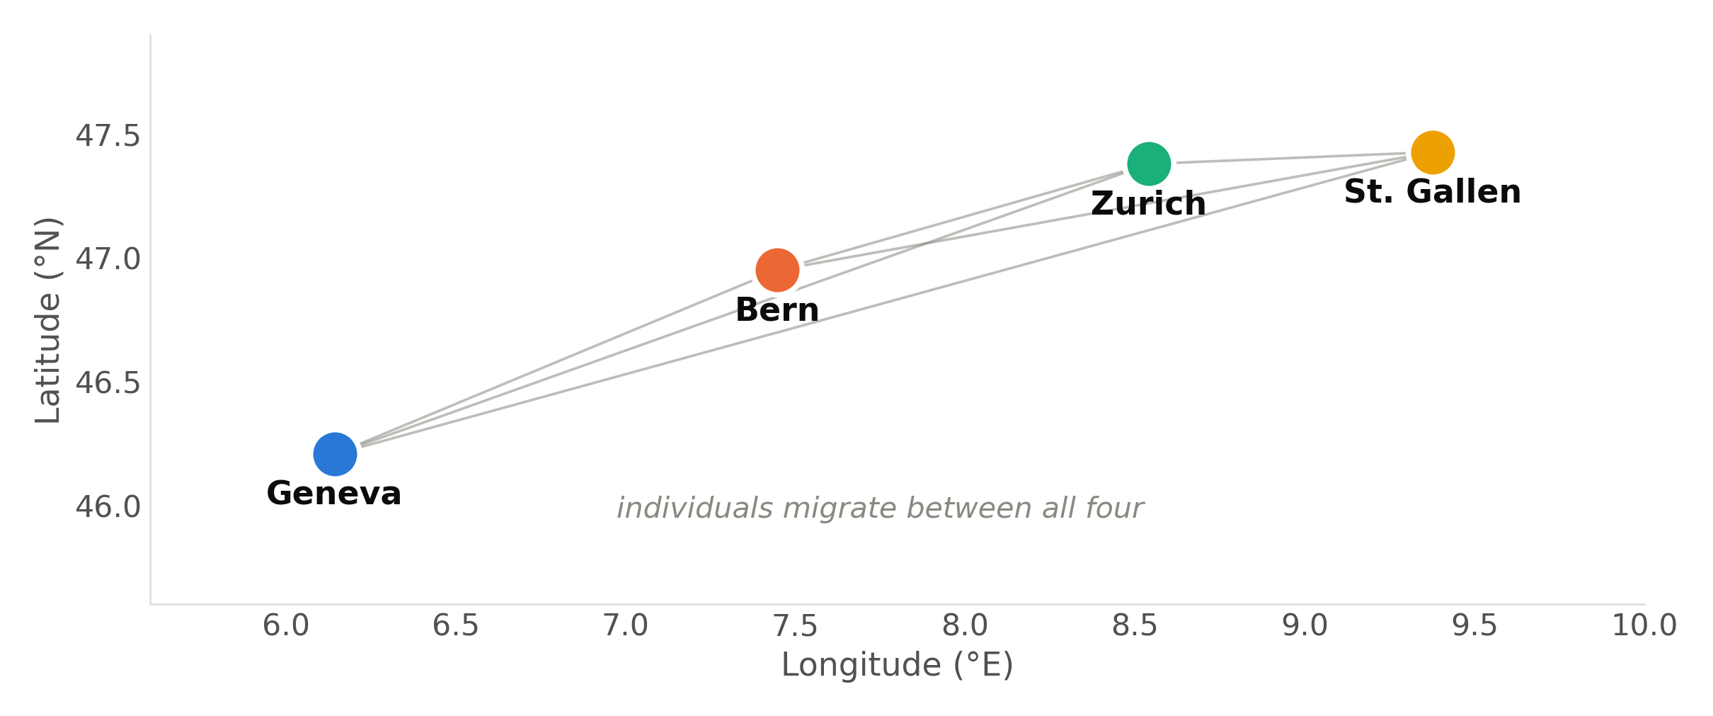
Method: four populations, four climates
Own climate
Own optimum
Migration I control
Notes:
Geneva, Bern, Zurich, St. Gallen — west to east across the Plateau. Each has its own temperature history and therefore its own local optimum, and individuals move between them at a rate I set. The geography is deliberately simple. This is a model organism, not a real species.

Slide 21
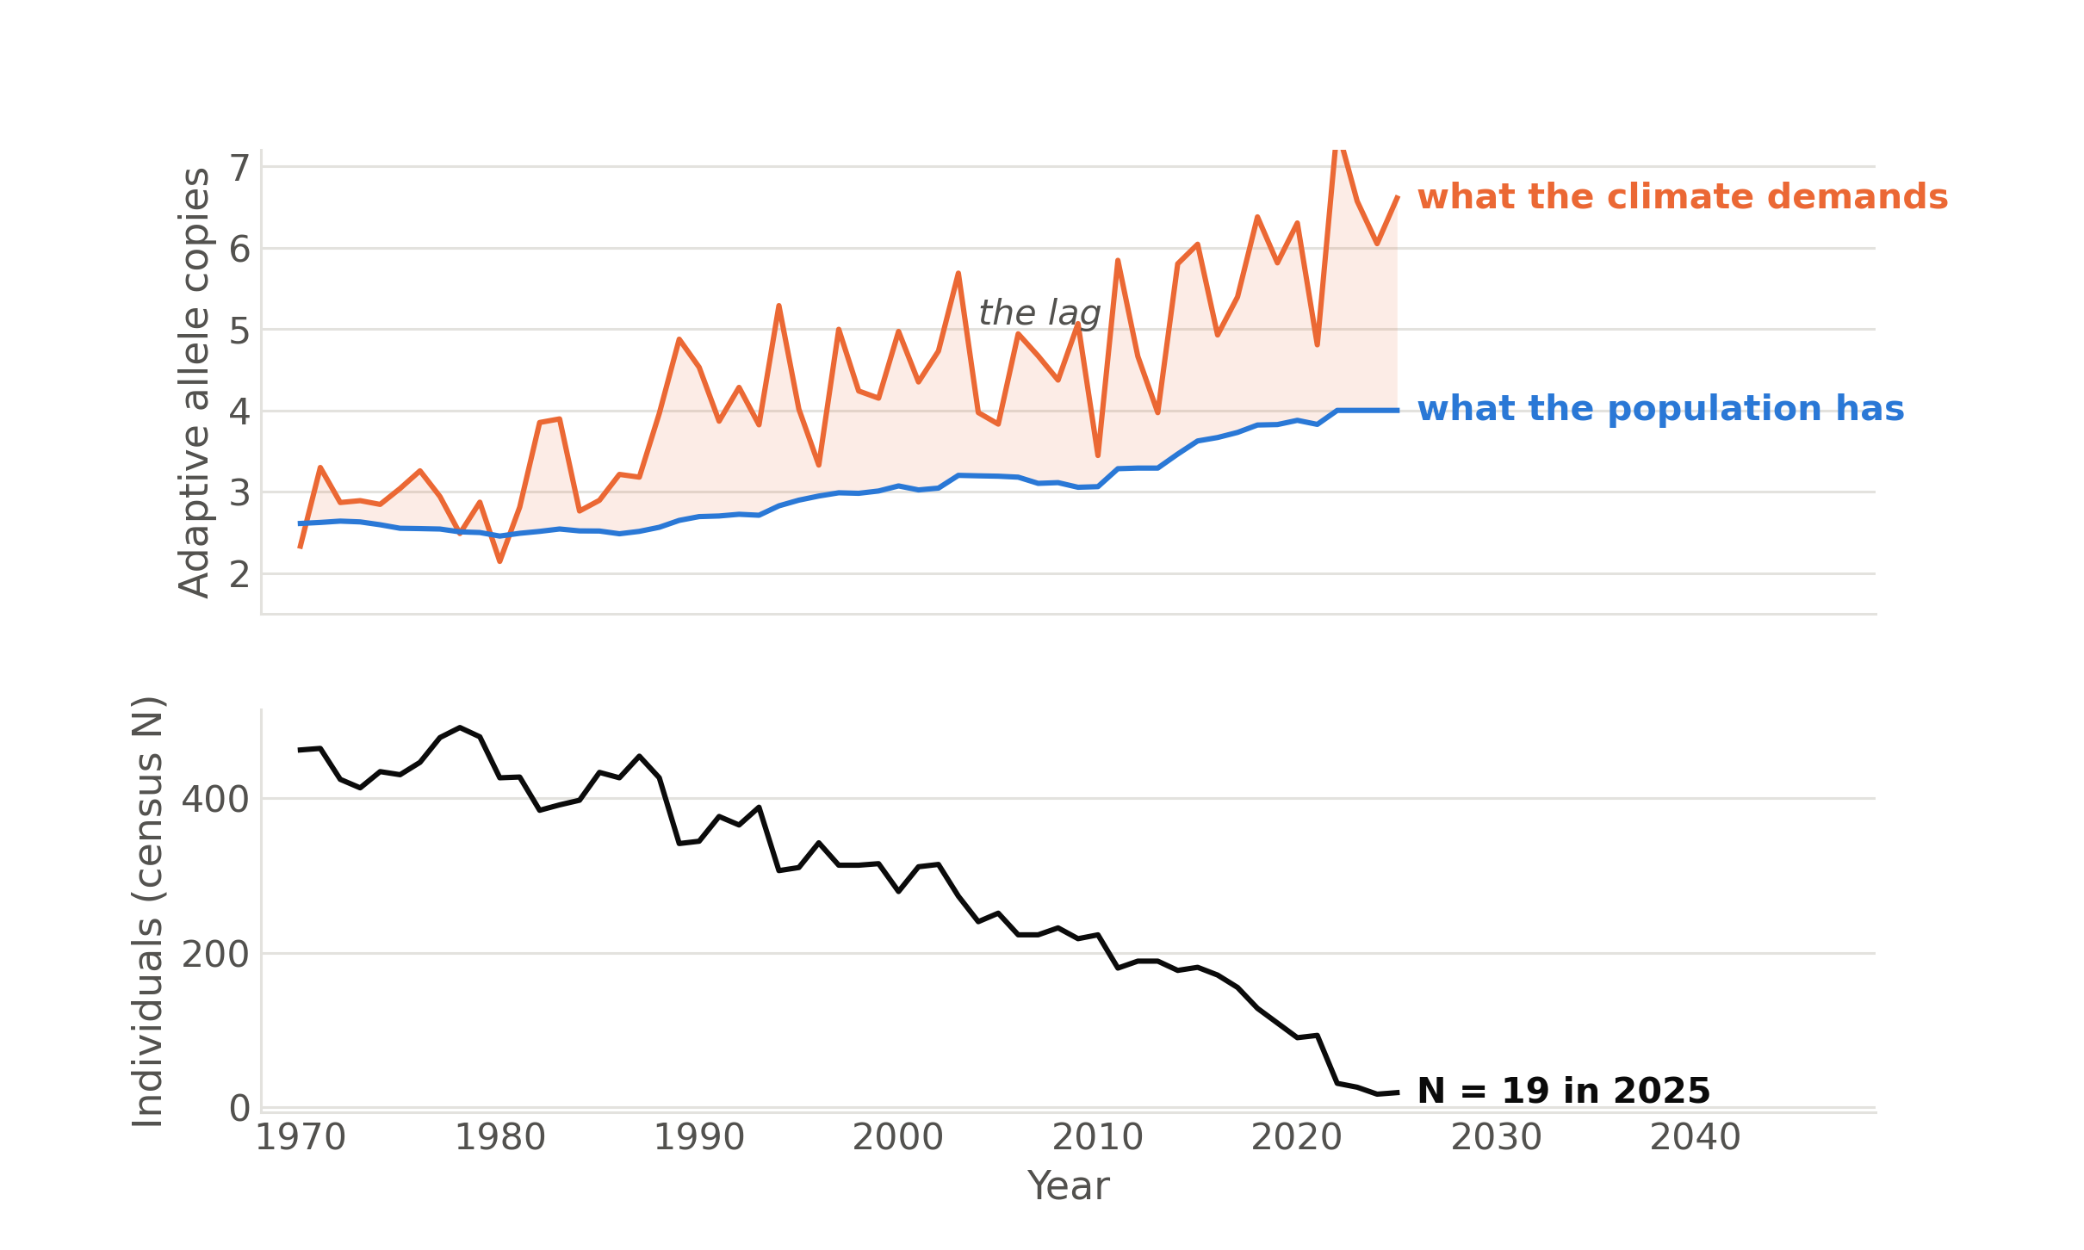
Method: mismatch with the climate costs fitness
The gap is the lag.
One run: weak migration, selection 0.05, K = 500, Geneva.
Notes:
Top panel: orange is what the climate now demands, in adaptive allele copies. Blue is what the population actually carries. It is adapting — the blue line climbs — but it never catches up. Bottom panel is the consequence. One run, one deme; I am showing it because it makes the mechanism visible, not because it is a result yet.

Slide 22
Method: twelve treatments, twenty replicates
Carrying capacity
Selection
Migration
500
0.050
weak
2 000
0.075
strong
5 000
3 × 2 × 2 × 20 = 240 runs
Notes:
A complete factorial: carrying capacity crossed with selection strength crossed with migration. Twenty seeds each, 240 independent runs, submitted as a job array on the cluster. Say the word replication out loud — this audience cares about it. Every seed is a deterministic function of the grid, so any run reproduces exactly.

Slide 23
Method: settle, adapt, then warm
predictor measured here
Settle
Hold
Observed climate
ticks 1–2000
ticks 2000–4000
1970–2025
4,055 generations per run.
Notes:
Two thousand generations to settle toward each deme's 1940-to-70 climate, two thousand more at equilibrium, then 56 years of the real record. Effective size — the predictor — is measured at the black dot, just before the observed warming starts. The burn-in is not decoration: without it I would be measuring my own starting conditions rather than an evolved state.

Slide 24
Method: measure before, compare after
1970
2025
Effective size
Who is left
Does the first predict the second?
Notes:
Concretely: measure effective size before the warming, measure the outcome after it, ask whether the first predicts the second — across 240 runs and twelve treatments, so I can also say under which conditions it works and under which it does not. That is the whole thesis in one slide.

Slide 25
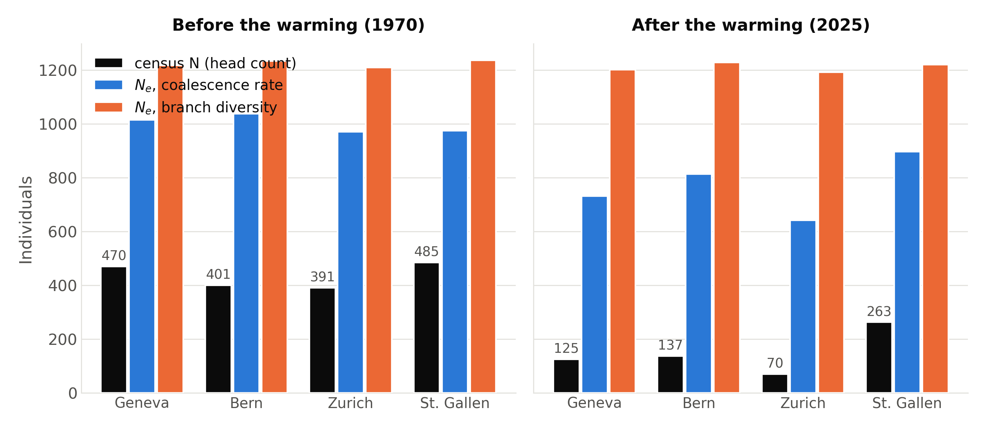
Result: connected demes inflate local effective size
Effective size ran 2–3× the local head count.
One tree-sequence run: ramp v2, K = 500, distance-decay migration. Preliminary.
Notes:
Black bars first: the head count roughly halves between 1970 and 2025. Now the orange bars: branch-based effective size does not move. And even before the warming, effective size sits at two to three times the local census. That is not a bug. With roughly ten immigrants per deme per generation, lineages traced backwards leave the deme before they can coalesce locally — so per-deme effective size is quietly reporting the whole metapopulation. Say plainly that this is about what per-deme Ne means under migration, not about the indicator's conversion ratio — my model has random mating, so Ne and Nc are close by construction and the ratio is not mine to comment on.

Slide 26
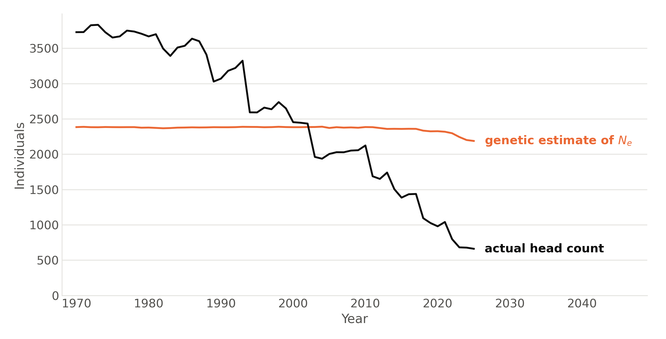
Result: the genetic signal lags the collapse
Population fell by five sixths. The estimate, by a twelfth.
One run, ramp v1.2, summed across the four demes. Heterozygosity-based Ne. Preliminary.
Notes:
This is the slide to land. Diversity-based measures integrate over the whole past, so they keep reporting a healthy population long after it has crashed. It is a property of the measure, not an error in my code — and it is exactly the failure mode a monitoring indicator cannot afford. Pause here.

Slide 27
A slow indicator reassures you too late
Estimates stayed flat
Populations collapsed
Monitoring says stable
Not wrong. Slow.
Deciding where to spend, those look the same.
Notes:
Close broad, the way you opened. Be careful not to overclaim: these are single preliminary runs. The honest statement is that the measures may lag, not that they are wrong. But if you are deciding where conservation money goes, a slow indicator and a wrong one look identical. Then: thank you, and questions.

Slide 28
Thank you
Billy Wallisch
Spatial Genomics Group
Department of Geography
University of Zurich
SLiM — Haller & Messer
Climate — ERA5, 1940–2025
Notes:
Questions.

